Slide 1
Calor : A Realtime AI therapist
Project Proposal Presentation
by
Joel B Koshy ( 2247218), Neil Manoj C ( 2247224), Advaith R Rajesh ( 2247204)
Project Guide
Dr. Rajesh Kanna
Department of Computer Science
CHRIST(Deemed to be University), Bengaluru-29

Slide 2
AGENDA
Introduction
Alignment with SDG Goals
Existing Systems
Proposed System
Feasibility Analysis
Benefits of Proposed
Anticipated Outcomes
Plan of Work
References

Slide 3

1. Introduction
Calor serves as an innovative AI Realtime Therapist, offering accessible mental health support to individuals anytime, anywhere.
Calor utilizes advanced technologies, including Whisper ASR and machine learning models, to convert audio inputs into text and generate empathetic and contextually relevant textual responses.
One of Calor's key functions is the real-time analysis of user emotions through audio inputs.
Calor underscores the significance of leveraging AI for real-time therapy, addressing the increasing demand for mental health services.
Leveraging AI technologies allows Calor to provide a confidential and secure space for users, with sensitive data handled responsibly and ethically.
.

Slide 4

2. Alignment with SDG Goals
SDG 3: Good Health and Well-Being:
Contribution: Calor contributes to SDG 3 by providing accessible mental health support. It helps address mental health issues and promotes well-being by offering a convenient and immediate avenue for individuals to seek therapy.
SDG 9: Industry, Innovation, and Infrastructure:
Contribution: Calor leverages advanced technologies, including Whisper ASR and machine learning models, showcasing innovation in the mental health sector. The project represents a technological infrastructure that enhances the delivery of mental health services.
SDG 10: Reduced Inequalities:
Contribution: Calor plays a role in reducing inequalities in accessing mental health support. By providing a platform that is accessible to individuals regardless of geographical location or socio-economic status, Calor contributes to creating a more inclusive mental health landscape.
SDG 17: Partnerships for the Goals:
Contribution: Calor can contribute to SDG 17 by fostering partnerships with mental health organizations, therapists, and communities. Collaborations can enhance the reach and impact of mental health support, aligning with the goal of global cooperation.
SDG 16: Peace, Justice, and Strong Institutions:
Contribution: Calor indirectly supports SDG 16 by addressing mental health issues, which are often linked to peace and stability.

Slide 5

Existing System
1)Woebot:
Features:
Offers cognitive-behavioral therapy through a chatbot interface.
Provides daily check-ins and mood tracking.
Challenges:
Lack of personalized human interaction: While chatbots can offer support, some users may miss the depth of interaction provided by human therapists.
2) Headspace: Features:
Focuses on meditation and mindfulness.
Offers guided meditation sessions for stress, anxiety, and sleep.
Challenges:
Limited depth in therapeutic approaches: While effective for some, individuals with more complex mental health needs might find the app's focus on meditation less suitable.

Slide 6
Existing System
3)BetterHelp:
Features:
Matches users with licensed therapists for online counseling.
Allows users to communicate via messaging, live chat, phone, or video.
Challenges:
Wait times for matching: Some users have reported delays in finding an available therapist, impacting the immediacy of support.
4) Talkspace: Features:
Connects users with licensed therapists for text, audio, and video sessions.
Offers therapy plans for individuals, couples, and teens.
Challenges:
Subscription costs: Affordability can be an issue for some users, especially if they don't have insurance coverage for online therapy.

Slide 7
Proposed System
Implement advanced emotion analysis techniques to enhance the system's understanding of users' emotional states.
Integrate sentiment analysis to better gauge the nuances of user emotions
.
The system employs a client-server architecture, with a web app running on devices and the server side using technologies like Docker, Python, and Flask for efficient development.
To use “Calor“, a stable internet connection and suitable hardware are required.
Utilize advanced natural language processing (NLP) models to ensure accurate comprehension and response generation across multiple languages.

Slide 8
Proposed System
Implement user profiles that store preferences, therapy history, and specific areas of concern.
Provide users with real-time feedback on their mental health progress.
Introduce interactive therapeutic exercises and resources within the platform.
Implement a system for users to provide feedback on the therapy experience.
Commit to regular updates to incorporate the latest advancements in AI, mental health research, and user experience design.

Slide 9
Key Features
Speech-to-text Conversion: “Calor" uses speech recognition to convert spoken lectures into concise summaries, enhancing note-taking efficiency for educators.
Real-time therapeutic response: It provides real-time response during conversation, ensuring immediate access to up-to-date content highlights.
Web-Based Data Management: The system offers a user-friendly web-based platform for individuals to talk and analyze emotions, facilitating review and sharing with user.

Slide 10
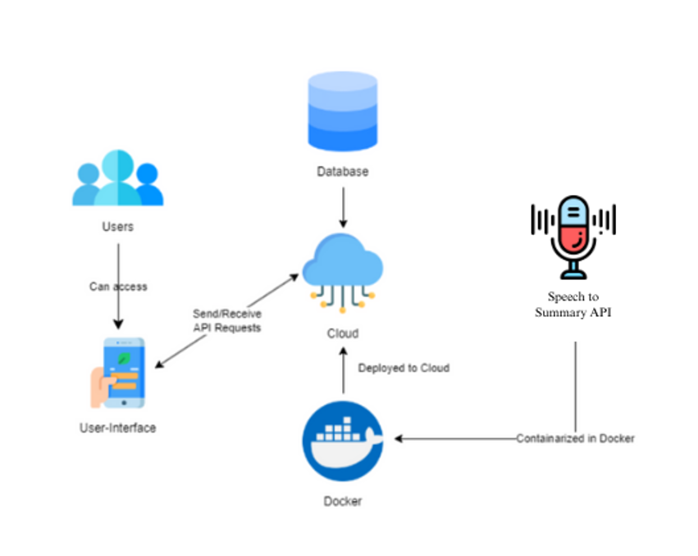
Proposed Solution Architecture

Slide 11
Software & Hardware Requirements
Web App: Requires microphone access and sufficient processing power for real-time speech recognition on various devices.
Server: Needs ample processing power, storage, and memory for efficient data management, running on a secure OS, and utilizing technologies like Python, Flask, or Node.js for the web interface.
Database: Utilizes a relational database system (RDBMS) like MySQL or PostgreSQL for data storage.
Speech Recognition Models: Integrates various speech recognition models into the system.
Internet Connectivity: Depends on a stable internet connection for real-time communication between devices and the server.

Slide 12
Feasibility Analysis
Time Feasibility: The project's development timeline is estimated at 2-3 months, including testing and refinement.
Cost Feasibility: Expenses include development tools, salaries, potential hardware costs, and ongoing maintenance.
Technical Feasibility: Evaluate speech recognition libraries, ensure scalability, and prioritize data security. The integration challenges with the cloud environment.
Implementation Issues: Address data privacy compliance, provide user training, and ensure device compatibility.

Slide 13
Resource Feasibility: Secure a skilled workforce and necessary hardware and software resources.
Operational Feasibility: Assess user acceptance and consider integration with existing systems.
Risk Analysis: Identify potential risks and develop mitigation strategies for technical, security, and scheduling challenges.

Slide 14
Benefits of Proposed System
Advanced Emotion Analysis:
Benefit: Improved understanding of user emotions.
Explanation: Enhanced emotion analysis allows for more nuanced and accurate responses, ensuring a deeper level of empathy and support.
Expanded Language Support:
Benefit: Inclusivity for a diverse user base.
Explanation: By supporting a broader range of languages and dialects, Calor becomes more accessible to individuals from various linguistic backgrounds.
Multimodal Input Integration:
Benefit: Increased flexibility in communication.
Explanation: Allowing users to express themselves through various forms, including text, images, or emojis, enhances the user's ability to convey emotions and experiences.
Personalized User Profiles:
Benefit: Tailored therapy experiences.
Explanation: User profiles help customize responses based on individual preferences, history, and specific areas of concern, leading to more personalized and effective interactions.
Real-Time Progress Tracking:
Benefit: Empowering users through self-awareness.
Explanation: Providing real-time feedback and progress tracking enables users to actively participate in their mental health journey and celebrate achievements.

Slide 15
Anticipated Outcomes
Enhanced Report Making: to improve report accuracy and efficiency by utilizing speech recognition technology.
Time and Resource Savings: The system is expected to save valuable instructional time and reduce administrative overhead, leading to cost savings for educational institutions. These resources can be reinvested to enhance the quality of education, ultimately improving the learning experience for students.

Slide 16
Plan of Work
Project Initiation: Define scope, objectives, and stakeholders, establish a project team, and set up communication channels and documentation procedures.
Requirement Analysis: Collaborate with educators, assess feasibility, and define detailed system requirements, both functional and non-functional.
System Design: Create system architecture, wireframes, and security plans with scalability in mind.
Development and Testing: Build the mobile app, integrate facial recognition, and conduct thorough testing to ensure reliability.
Deployment: Securely deploy the system, configure user access, and provide training and support.
Monitoring and Maintenance: Continuously monitor performance, security, and data integrity, addressing user feedback and performing updates as necessary.

Slide 17
References
Introduction to Automatic Speech Recognition – Zahra Ahmad
Audio Deep Learning Made Simple: Automatic Speech Recognition (ASR), How it Works – Ketan Doshi
BottleSum: Unsupervised and Self-supervised Sentence Summarization using the Information Bottleneck Principle - Peter West,Ari Holtzman,Jan Buys,Yejin Choi
Searching for Effective Neural Extractive Summarization: What Works and What's Next - Ming Zhong,Pengfei Liu,Danqing Wang,Xipeng Qiu,Xuanjing Huang

